Slide 1


National Service Convenience
to provide convenience and flexibility in giving feedbacks and making reports.
Joanne, Apurva, Shen Hwei, Zi En
Notes:
NSC, provides the convenience and flexibility in giving feedbacks and making reports.

Slide 2
Creation of NSC
01
02
03
Target
Audience
App
Features
Advantages over Current measures
Notes:
First, we will introduce our target audience, followed by our app features, and lastly the advantages our app have over current measures.

Slide 3
Reservist NS men
Who uses our app?
NS men
NS workers
More likely to use our app and be on the outlook for faulty equipment or facilities after being in NS for 2 years.
As they use the facilities themselves
For management
Notes:
Firstly, reservist NS men may more likely use our app as they are more able to expertly spot faulty equipment and would be more concerned about reporting them.
Secondly, NS Men, as they use the facilities for 2 years
Lastly, NS Workers for the purpose of management

Slide 4
App Features
Reporting faulty equipment and facilities
Notes:
Next, onto our app features.

Slide 5
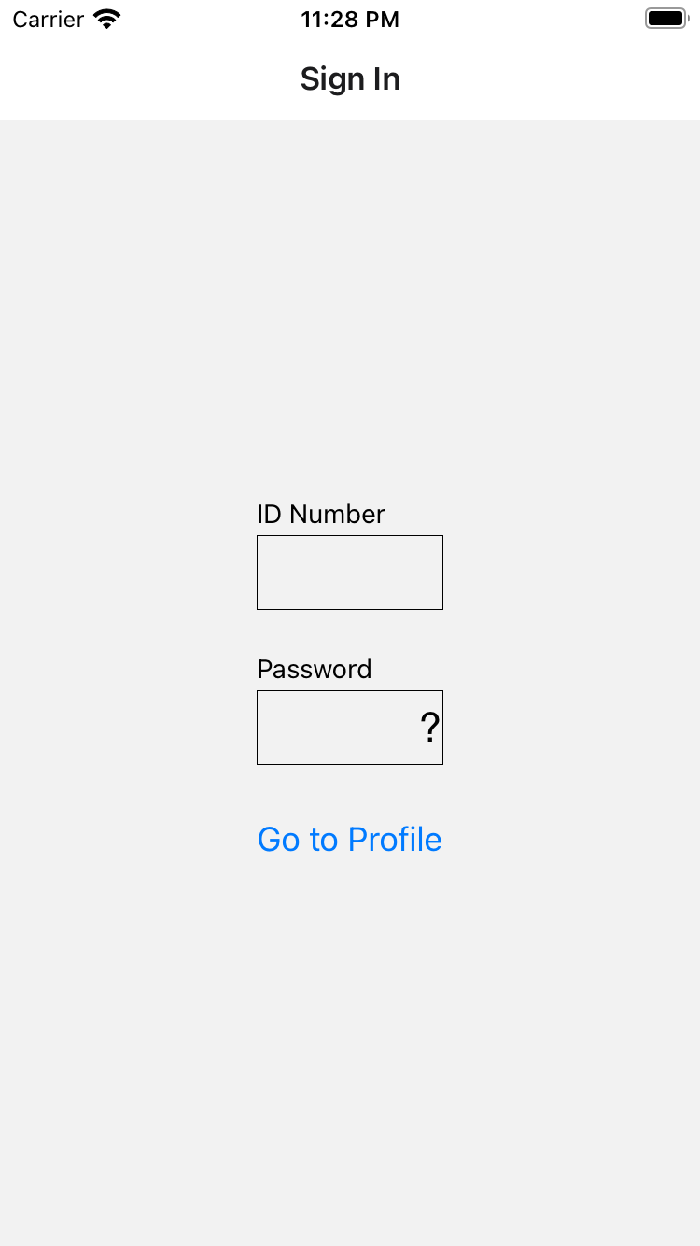
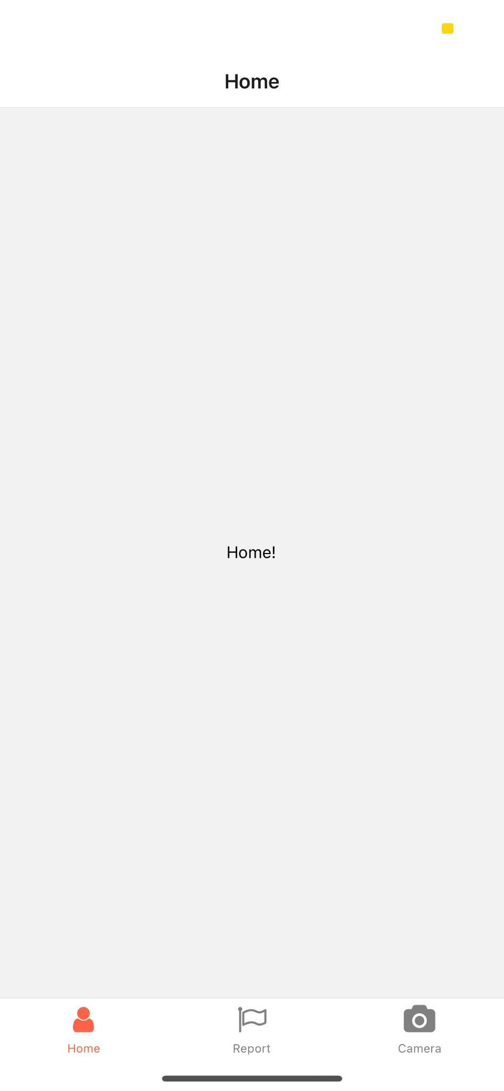

Exclusivity
Coded
Coded
Only users that are NSMen / NSWorkers can access this application
Notes:
Accounts are exclusive to NSMen and NS Workers

Slide 6
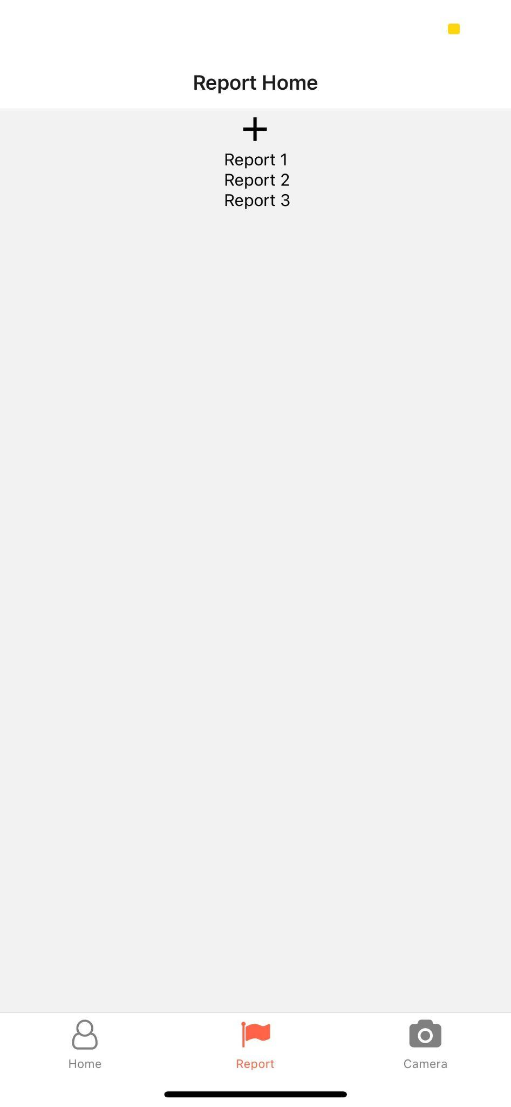
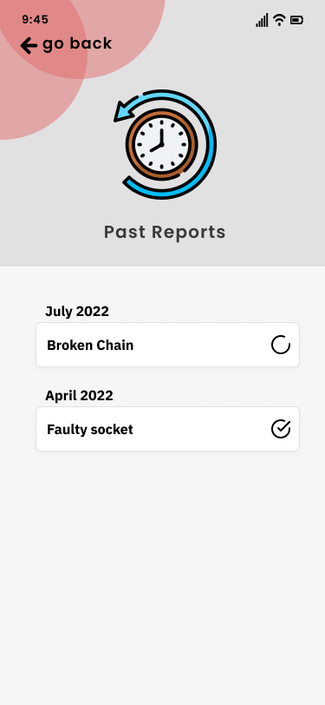
Report Screen
Coded
Prototype
Tap the plus icon to add a report
Report log is shown on the screen
It will show the status of the report : Complete/ Pending
Notes:
Our main feature is the reporting system where users can see their past reports as well. And status of the reports is shown as complete/ pending

Slide 7
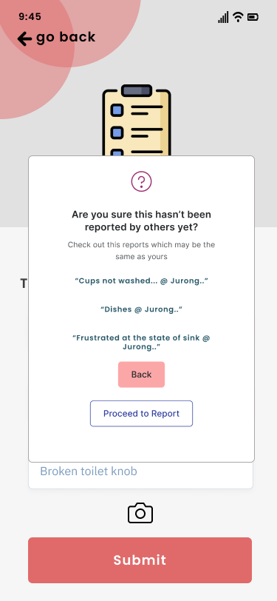
Report System – prevention of spam
Before submitting the report, an algorithm will run through to ensure that the report hasn’t already been made
Voting System – users can vote the reports if they are making the sae report as a submitted report by another user.
More votes == more attention by top, this incentivises users to not spam
Notes:
Before submission, an algo will run through to alert the user of any similar reports reported by other users that may be the same. If the report is the same, the user can click onto the report and vote the report.

Slide 8
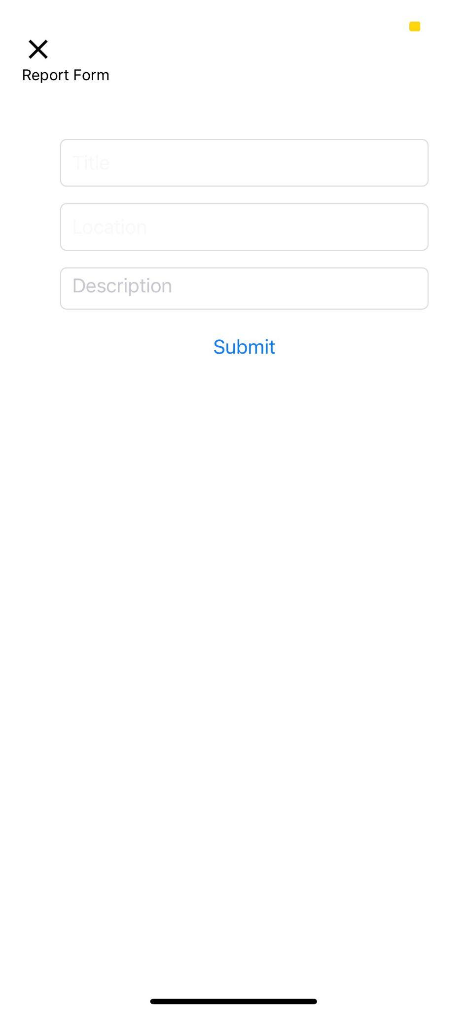
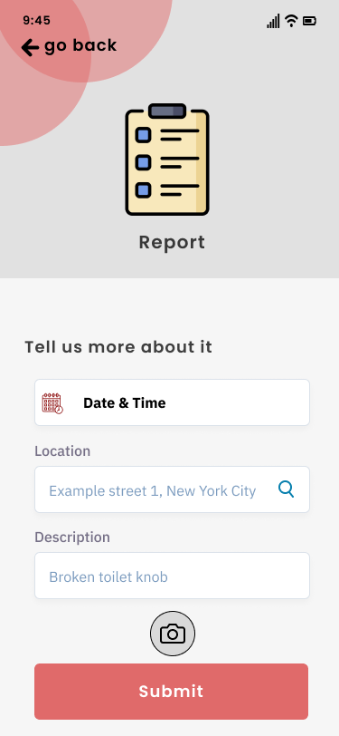
Report Form
Coded
Prototype
After tapping the plus icon, the user will be shown this report form
The form has the title, description and location boxes to fill in
After filling in the form, the user can tap the submit button to submit the form
The user can tap the X icon to cancel the report form anytime
Notes:
The layout of the report includes a camera feature

Slide 9
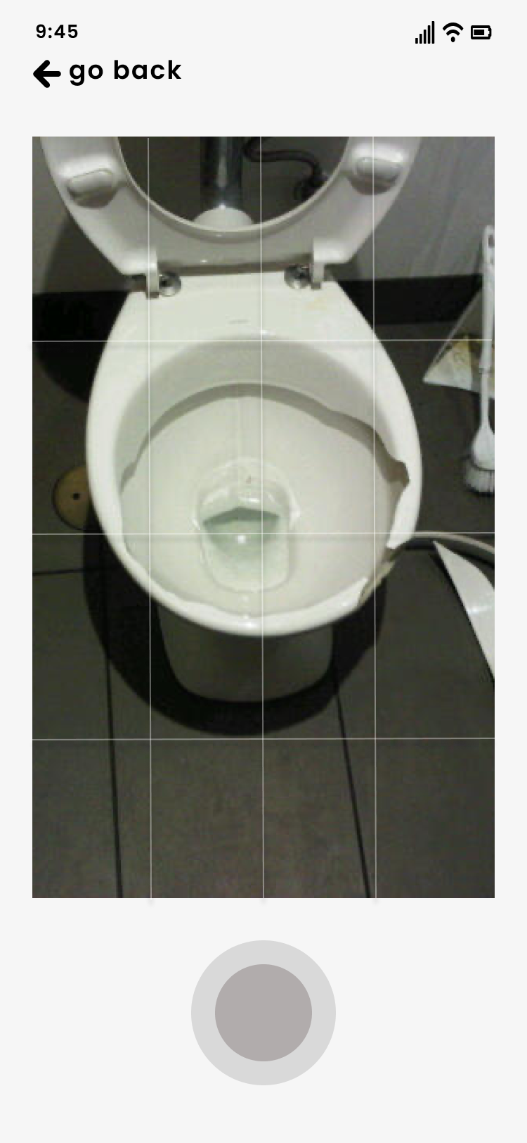
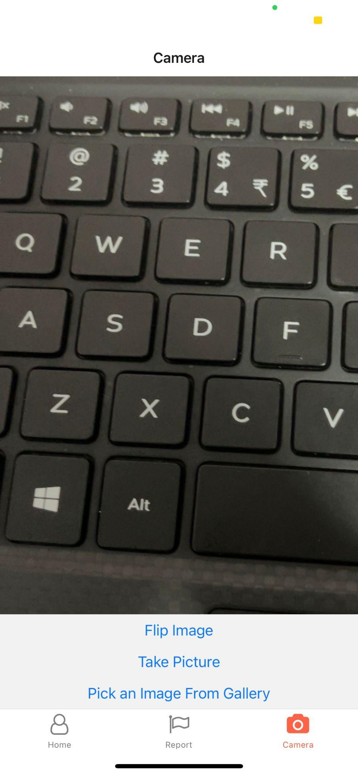
Camera Screen
Prototype
Coded
Camera feature for users to take pictures of faulty equipment etc
User can flip image, take picture, and pick an image from gallery
Notes:
users can take picture or pick an image from their gallery.

Slide 10
Advantages
Over Current measures
Notes:
Lastly, for our app’s advantages

Slide 11
Convenience & Flexibility
Current measure of QR codes for fault reporting is not widely used
Our app allows NS men to report faults anytime, anywhere
No need to paste QR codes everywhere
No need to search for a QR code to report faulty equipment
Notes:
We heard our NS men express that they want a more convenient way for fault reporting as the current QR code implementation is not very convenient. With our app, NS men can report faults anytime, anywhere. There's no need to paste and search for QR codes.

Slide 12
Sense of being heard
Creating a closer knit within the community
Notes:
Very importantly, our app helps NSMen to feel heard by the top management, creating a closer knit within the NS community

Slide 13
THANK YOU
Notes:
With that, we have come to the end of our presentation. Thank you!

Slide 14
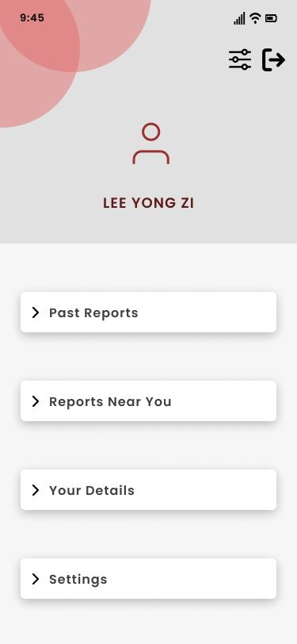
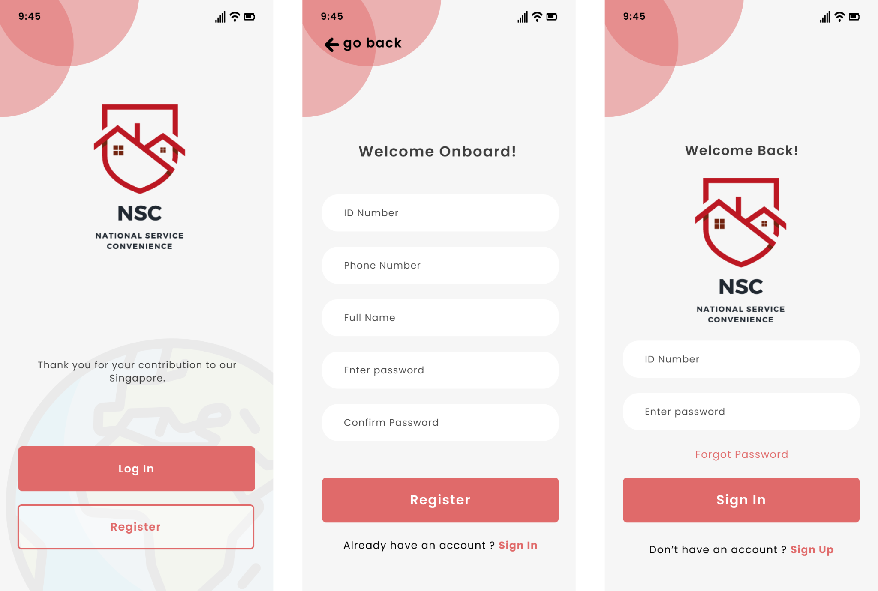
Prototype for
Profile
Sign In
Notes:
This is our prototype for SignIn and Profile, red represents singapore well, thats why we chose it

